Slide 1
Epidemiology of cervical cancer in India: Where do we stand today
Dr Seema Singhal
Department of Obstetrics and Gynaecology
AIIMS New Delhi

Slide 2


Cervical cancer disease burden
High incidence rates
Deterioration of key risk factors
Low detection rates
Notes:
Cervical cancer is a major public health problem in India and India bears a huge disease burden because of higher incidence rates lower detection rates and deterioration in the risk factors

Slide 3
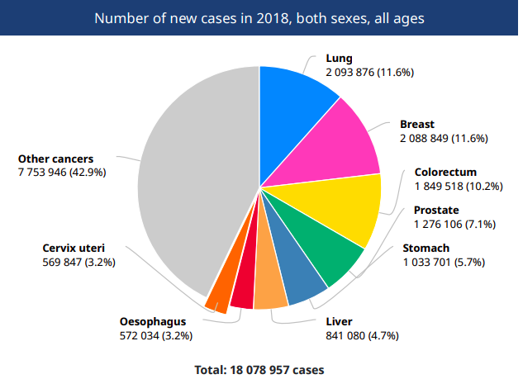
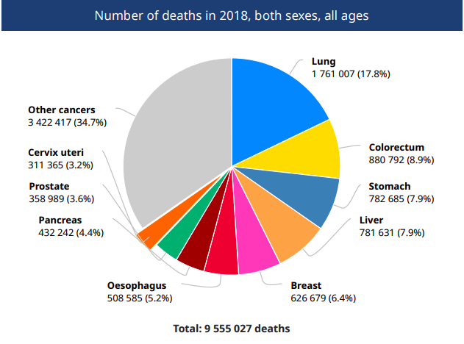
Global Incidence and mortality in 2018

Slide 4
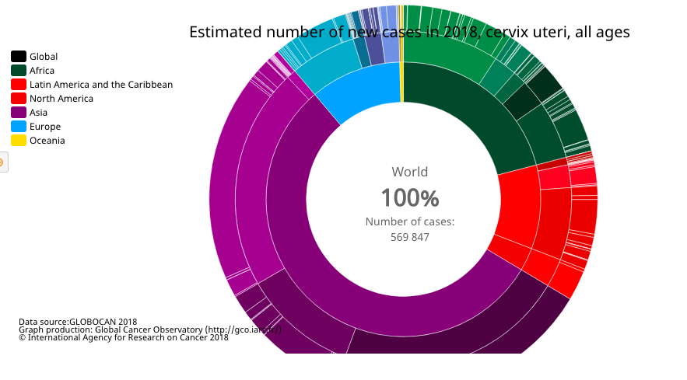
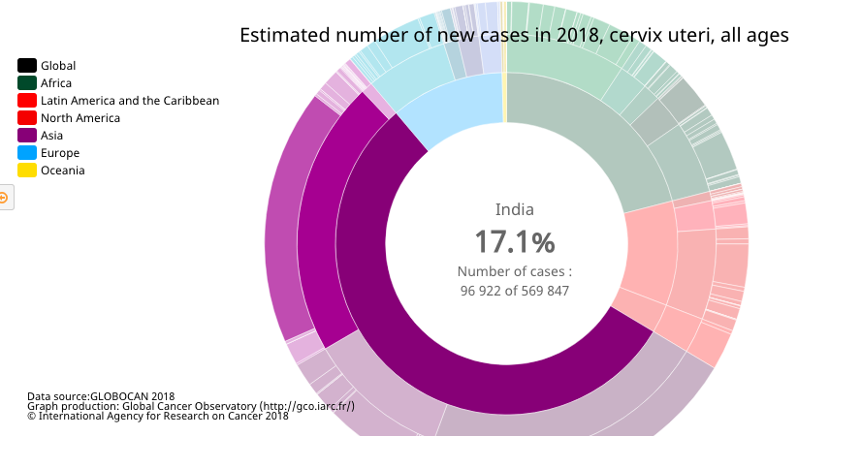
India : Major contributor to global burden of cervical cancer
Notes:
If u look at the contribution of India to global burden of cervical cancer

Slide 5
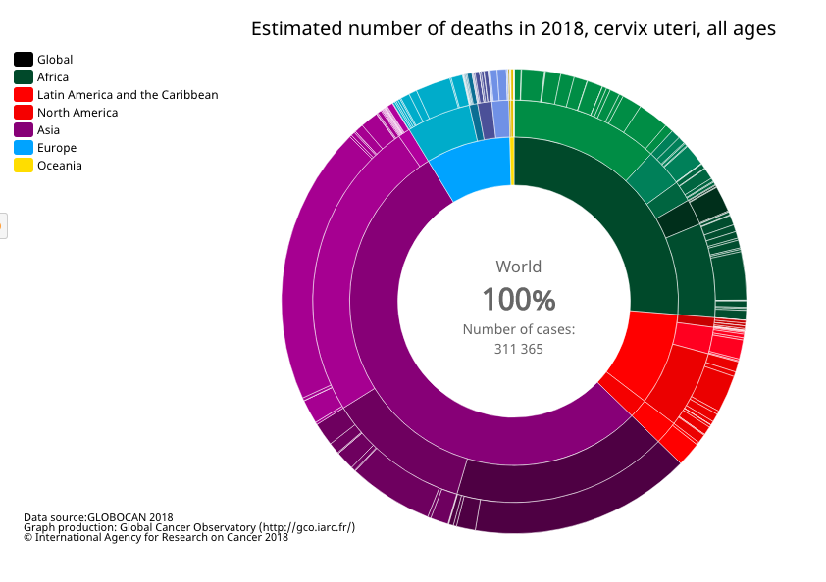
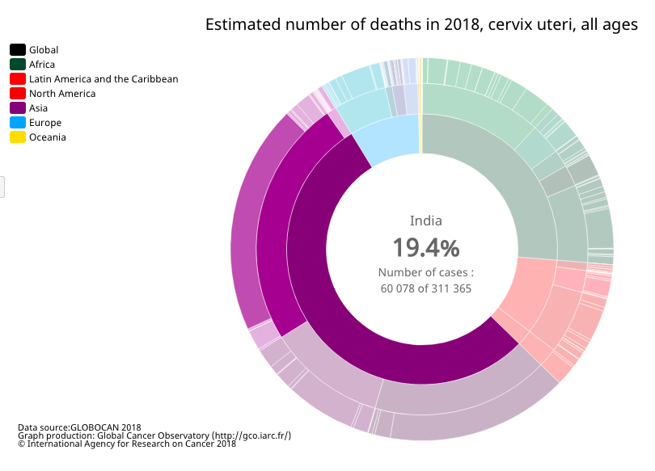
High mortality

Slide 6
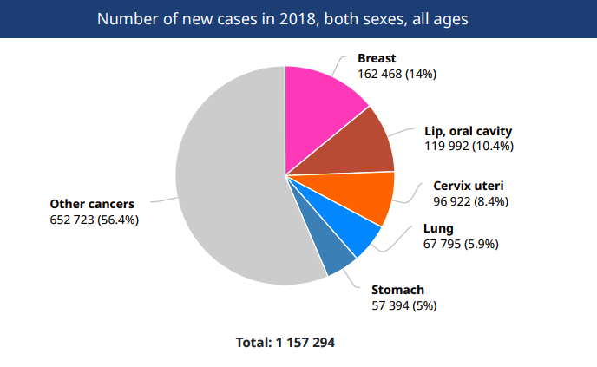
Distribution of cervical cancer in India

Slide 8
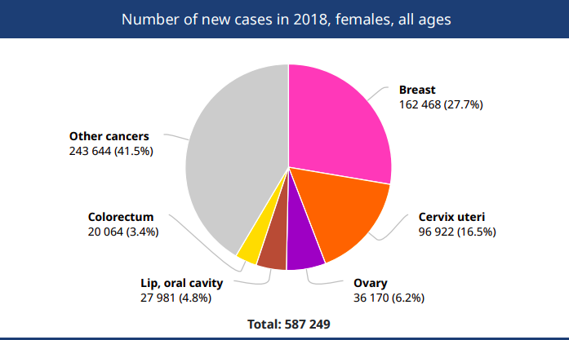
Distribution of cervical cancer in India and Trends
Peak age for cervical cancer incidence in India: 55-59 years.
60 078 cases died

Slide 9
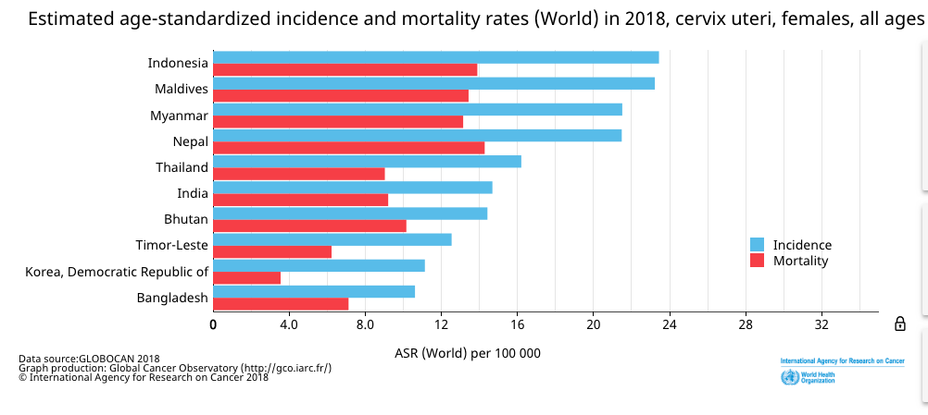
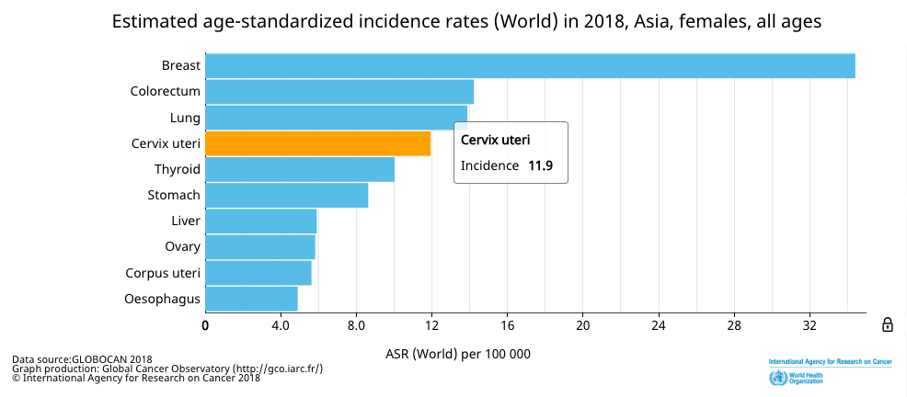
SEARO rgion

Slide 10
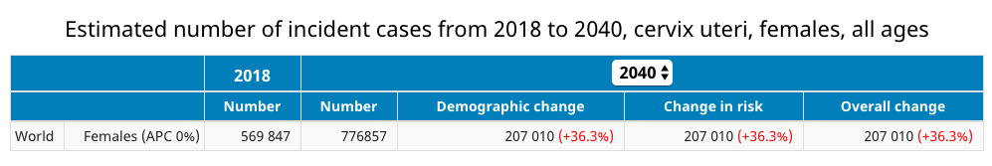
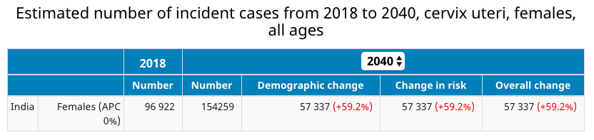

Slide 11
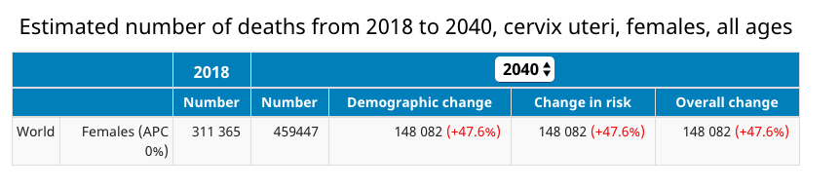
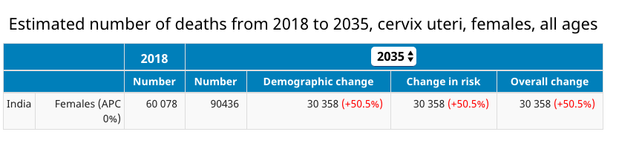
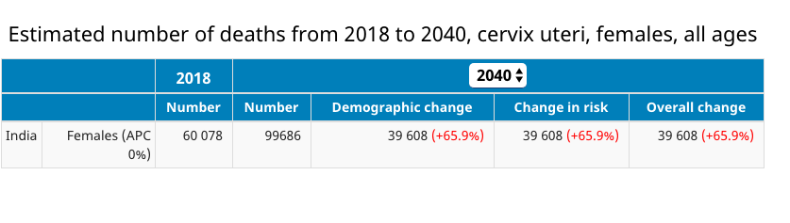

Slide 12
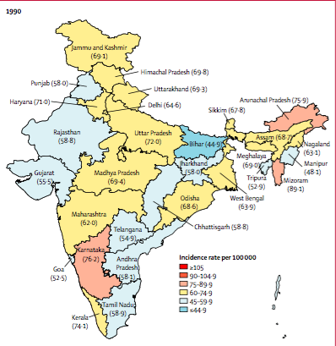
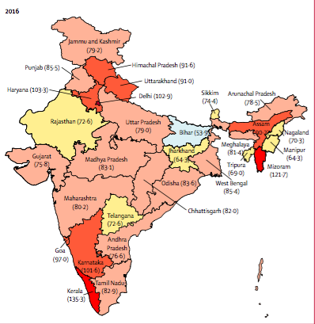
Age adjusted Incidence rates per 100 000 women
AAIR of CaCx varies widely between and within states

Slide 13
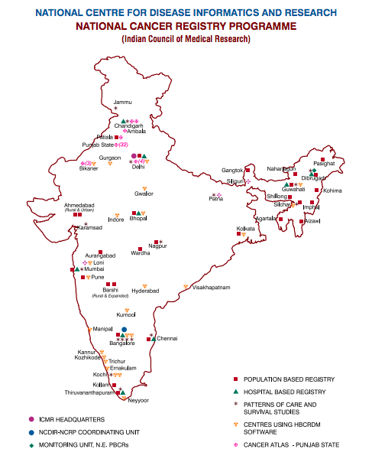
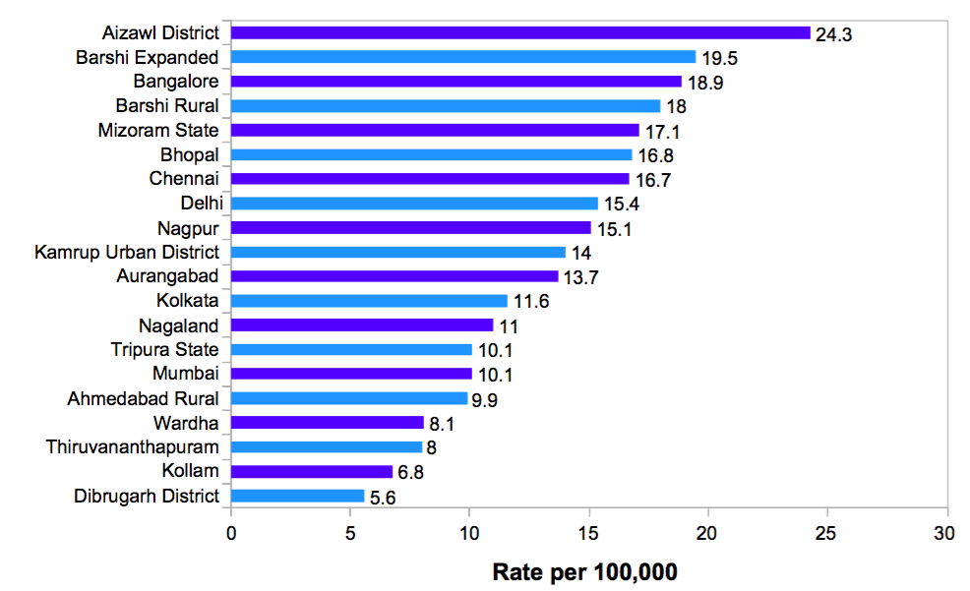
Age adjusted incidence rates of cervix uteri-females (rate per 100,000) in the various population based cancer registries.
Cervical cancer is the leading incident cancer site
Bangalore | 27.3%
Chennai | 25.4%
Guwahati | 16.3%
Chandigarh | 18.4%
(NCRP/ HBCR, 2013)

Slide 14
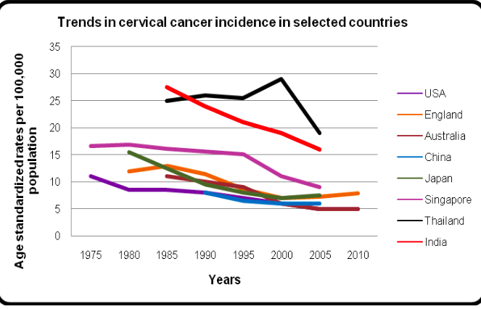
Trends in Cervical Cancer Incidence In Selected Countries (1975-2010)

Slide 15
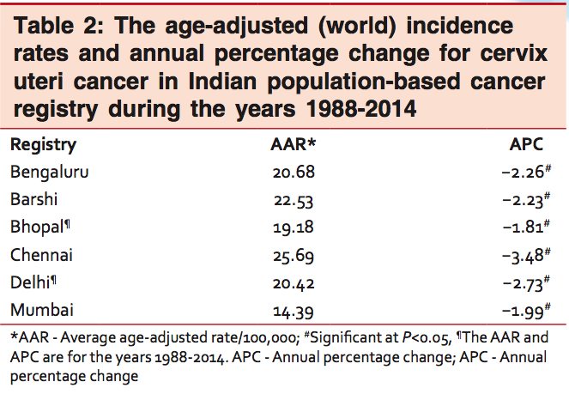
Annual percentage change for cervix uteri in Indian population based cancer registry
All the population-based registries have shown a
persistent decline in the age-adjusted rates even in the absence of a control program
The mean annual percentage decrease in the average age-adjusted rate ranged from 1.81% to 3.48% among various registries.

Slide 16
In Odisha, CaCx was the second most common cancer, with an increase in incidence of 3.1% from 2001 to 2011.
Hussain MA, Pati S, Swain S, et al (2012). Pattern and trends of cancer in Odisha, India: a retrospective study. Asian Pac J Cancer Prev, 13, 6333-36

Slide 17
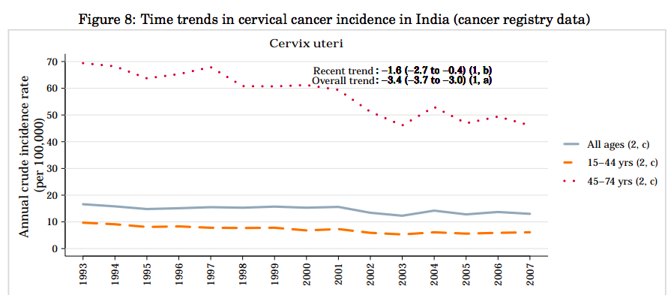
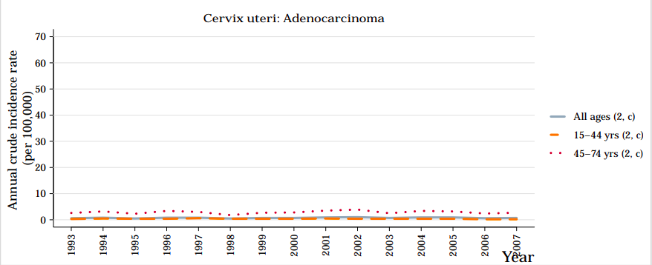
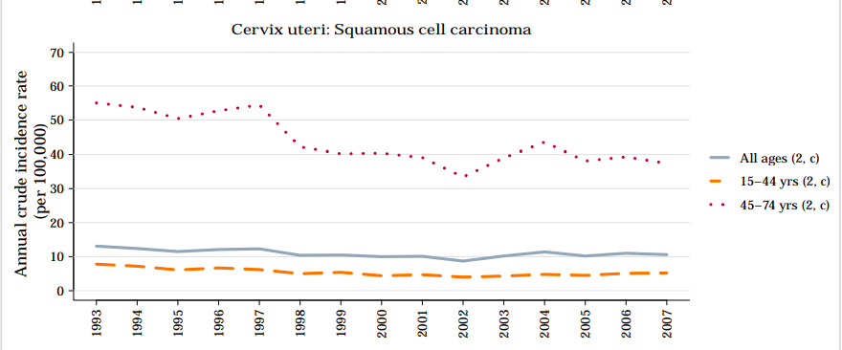
Time trends of cervical cancer in India
Cervical cancer rates among women in the 30–64 age group decreased by 1.8% per year on average but still accounted for 16% of the total female cancer burden.
70-80%
10-15%
Satija A. Cervical cancer in India. South Asia centre for chronic disease. Available from: http://sancd.org/uploads/pdf/cervical_cancer.pdf. Accessed February16, 2014.

Slide 18
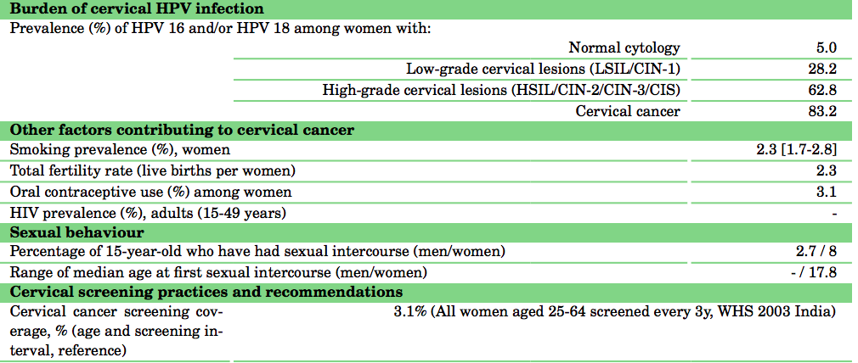
Prevalence of risk factors for cervical cancer

Slide 19
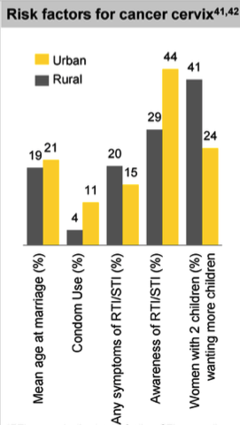
Risk Factors for ca cervix
Cervical cancer rates are higher in rural vs urban populations
Sexual Promiscuity
Poor Hygiene
Lack of awareness of risk factors
Low socio economic status,
Poor education

Slide 20
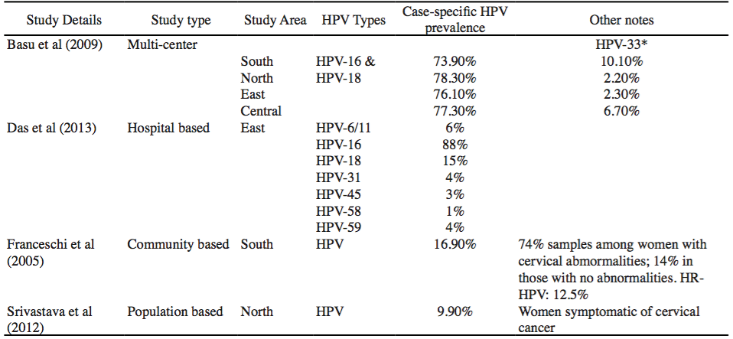
HPV agent types

Slide 21
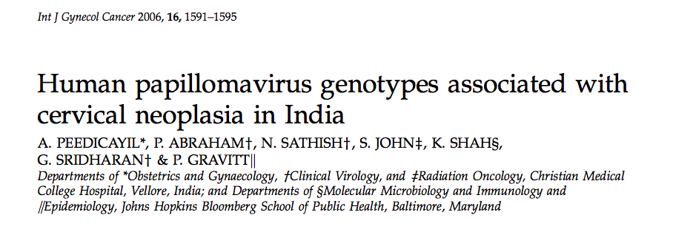
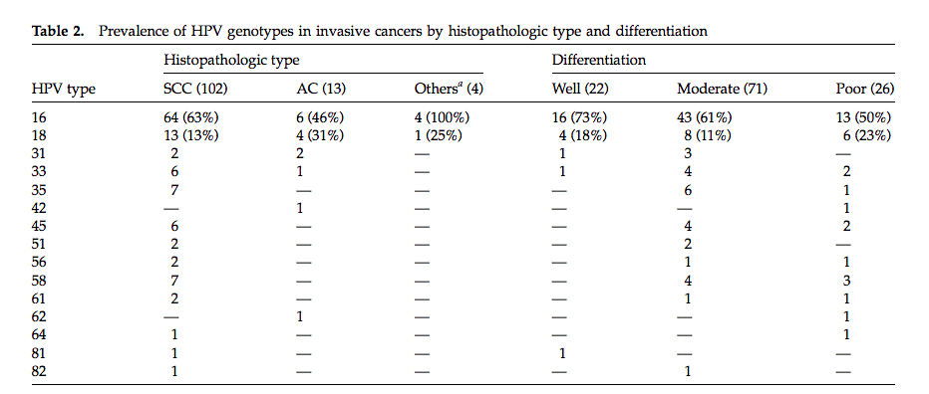
HPV DNA was detected in 95% of invasive cancers (113/119) and 91% of CINs (10/11).
A single HPV type was found in 100 women (77%), and mixed infections were found in 23 women (18%).
HPV 16 (60%) and HPV 18 (14%) were the most frequent types

Slide 22
High HPV prevalence in India
 | Women without cervical cancer | Women with benign cervical cytology
World | 9-13%
India | 7.5-16.9% | 9.9%-16.6%
India (sex workers) Urban slum ( Mumbai) | 25% 32.3%
India (HIV positive women ) | 41.7%-56%
North vs South India | No significant difference North India (16,45) South India (35)
Reference
Sreedevi A et al,. Epidemiology of cervical cancer with special focus on India. International Journal of Women’s Health 2015:7 405–414
Bhatla N, Lal N, Bao YP, et al. A meta-analysis of human papilloma- virus type-distribution in women from South Asia: implications for vaccination. Vaccine. 2008;26(23):2811–2817.

Slide 23
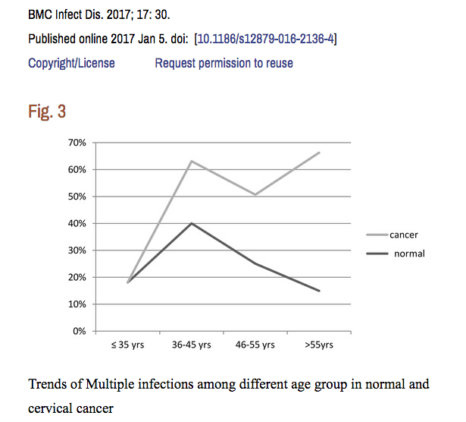
High persistence rates
A prospective study in Delhi indicated that persistence was higher for high-risk HPV type and the highest rate of persistence was found in types 16, 45, 67, 31, 51, 59.
Among the high-risk types, the mean duration of persistence due to HPV-16 was 12.5 months.
Prevalence of HPV-18 was greater than that of HPV-16, although HPV-16 was associated more frequently with HSIL.
Datta P, Bhatla N, Pandey RM, et al. Type-specific incidence and per- sistence of HPV infection among young women: a prospective study in North India. Asian Pac J Cancer Prev. 2012;13(3):1019–1024.

Slide 24
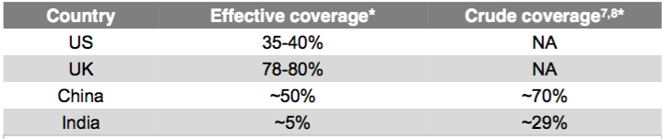
The coverage
Effective coverage: The proportion of eligible women (25-64 years) who report having had a pelvic exam and Pap smear in the past three years
Crude coverage : The proportion of women (25-64 years) who report having had a pelvic exam (regardless of when the exam occurred)
Data for the UK, the US for 2010; Data for India and China for 2008. Source: International Cancer Screening Network; Gakidou et al, 2008

Slide 25
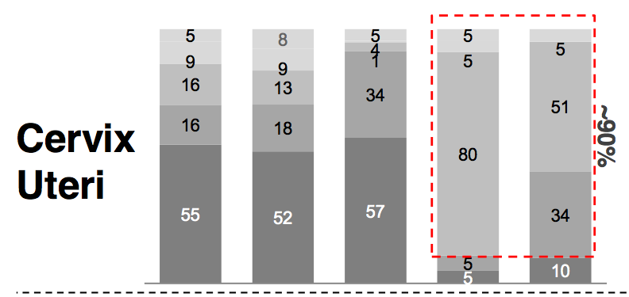
Poor detection rates
USA
UK
China
India
Cancer center
( India Metro)

Slide 26
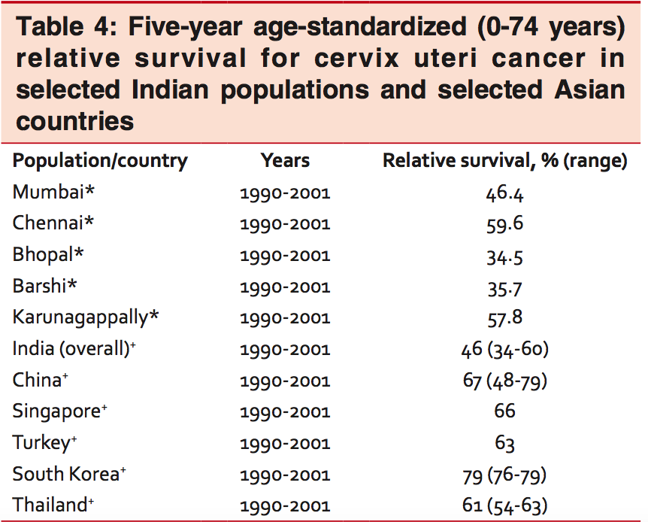
Survival rates
In addition, cervical cancer survival rates in India also shows a wide variation ranging from 59.6% in Chennai to 34.5% in Bhopal.

Slide 27

NON- PARTICIPATION

Slide 28

Limitations of available data
cover only 7% of the Indian population
under-represent the rural, northern and eastern regions of the country.
NCRP
IARC
Globocan
mainly derived from the west, south and central of the country
mainly derived from the west and south of the country

Slide 29
Conclusion
Essential to understand epidemiology of ca cervix in order to prioritize the needs
Mortality statistics and trends in cervical cancer are lacking due to inadequate and incomplete informa- tion on deaths.
Currently available epidemiological data do indicate quite clearly that HPV infection and associated Ca Cx risk in India is a substantial burden and clear health priority which need to be addressed now………

